Slide 1


Drone-to-Drone Collaboration for Agricultural Surveillance
Ali Hassan Abushaheen : 223011126
Mohammed Jassim Aleid : 223049614
Ali Abdulnasser Almashan : 222415704

Slide 2
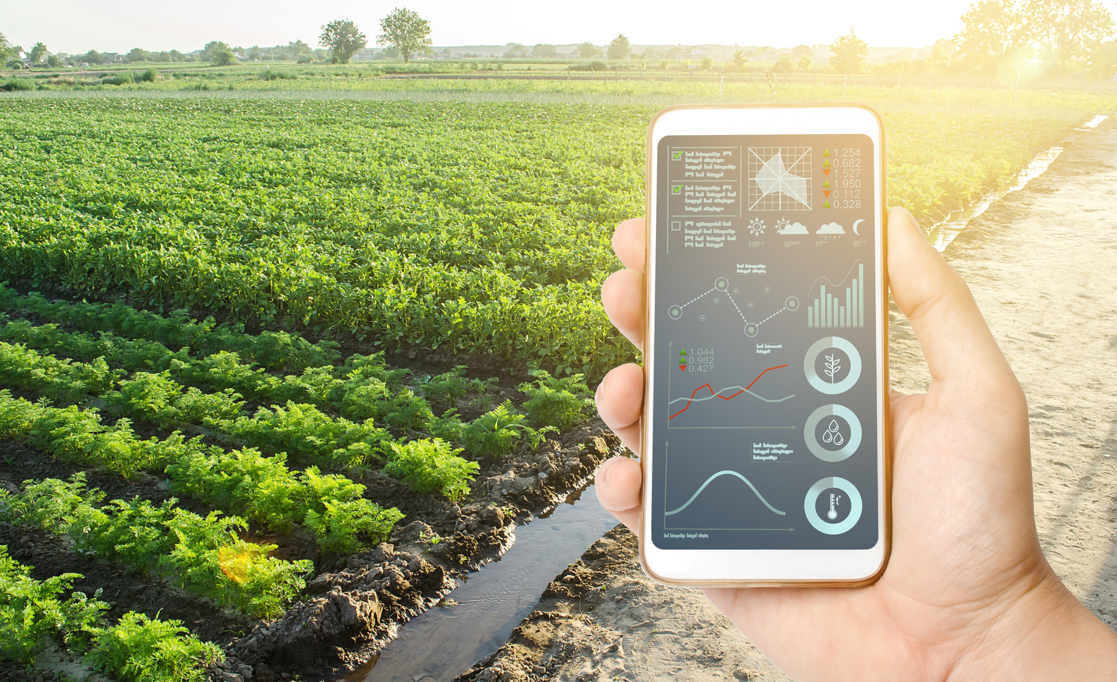
The Problem: We Need Smart Farming
The Problem: Old farming wastes water and money. It is hard to find small sicknesses in big fields. We need Smart Farming which uses good technology.

Slide 3
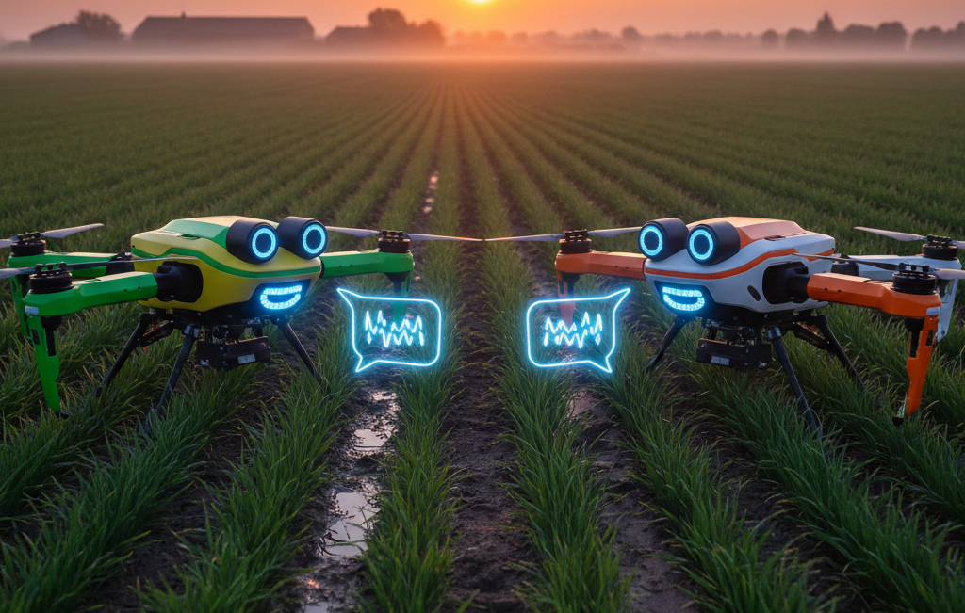
Our Solution: Collaborative Drones
Our Goal: Make a system where two drones work together. Drone 1: Looks for problems (The Sensor).
Drone 2: Goes fast to the problem spot (The Helper).
This saves time and battery power.

Slide 4
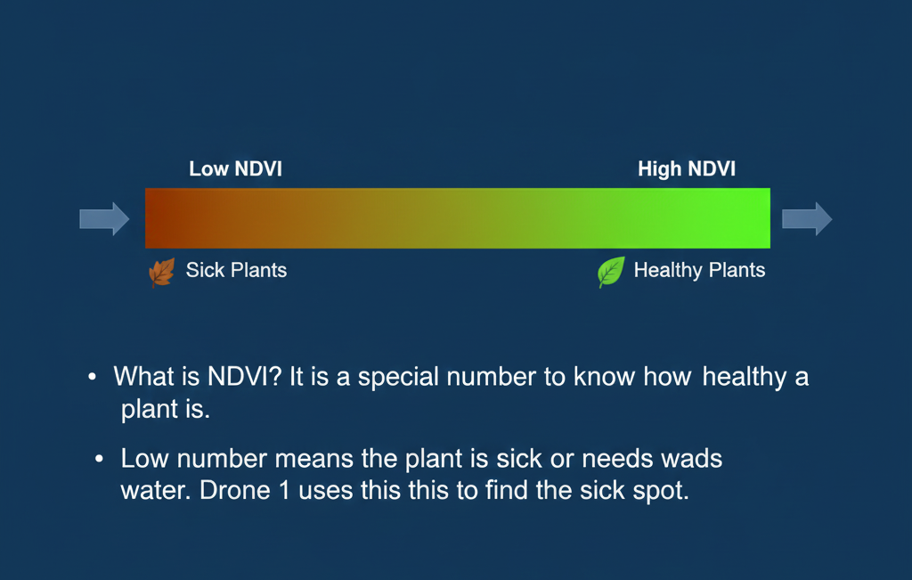
Tech Idea 1: NDVI (Plant Health Score)
What is NDVI? It is a special number to know how healthy a plant is. Low number means the plant is sick or needs water. Drone 1 uses this to find the sick spot.

Slide 5
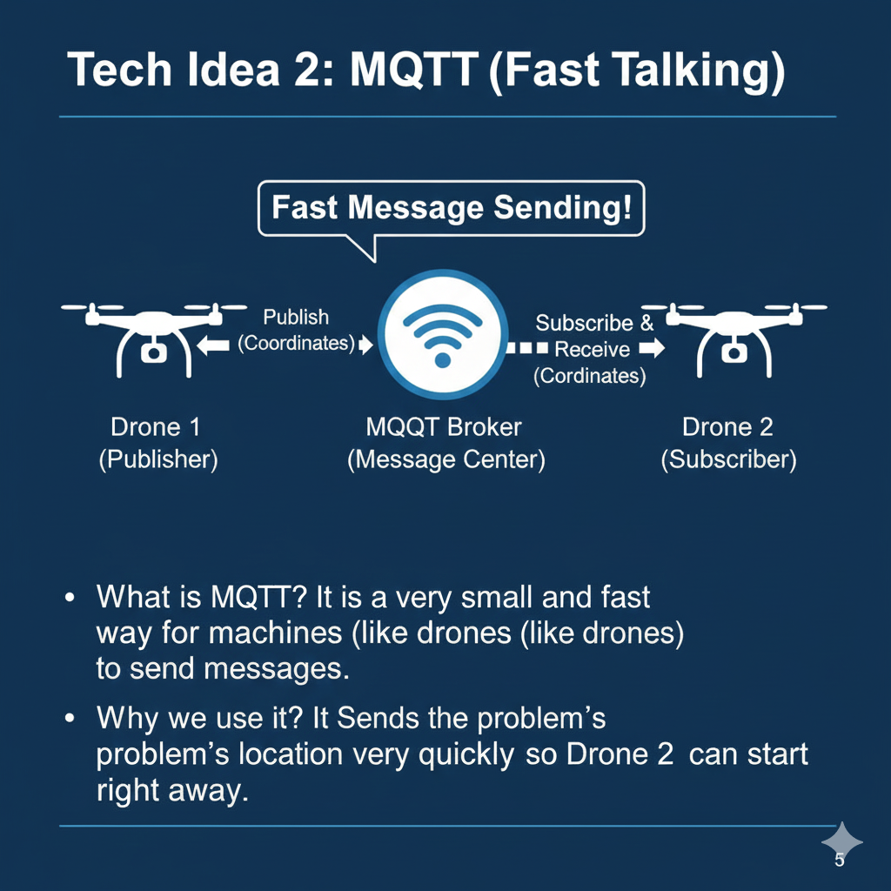
Tech Idea 2: MQTT (Fast Talking)
What is MQTT? It is a very small and fast way for machines (like drones) to send messages. Why we use it? It sends the problem's location very quickly so Drone 2 can start right away.

Slide 6

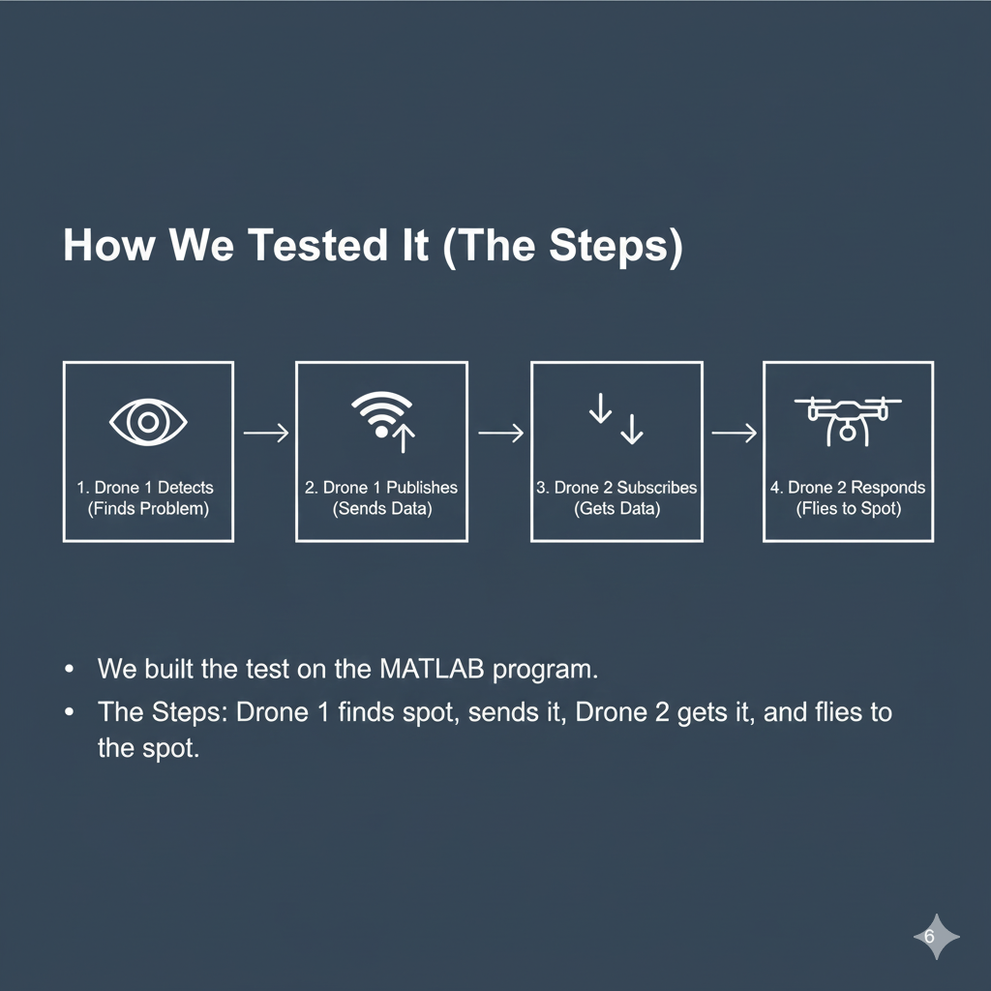
How We Tested It (The Steps
We built the test on the MATLAB program.
The Steps:
1. Drone 1 finds the spot.
2. Drone 1 sends the location (Publish).
3. Drone 2 gets the location (Subscriber).
4. Drone 2 flies to the spot.

Slide 7
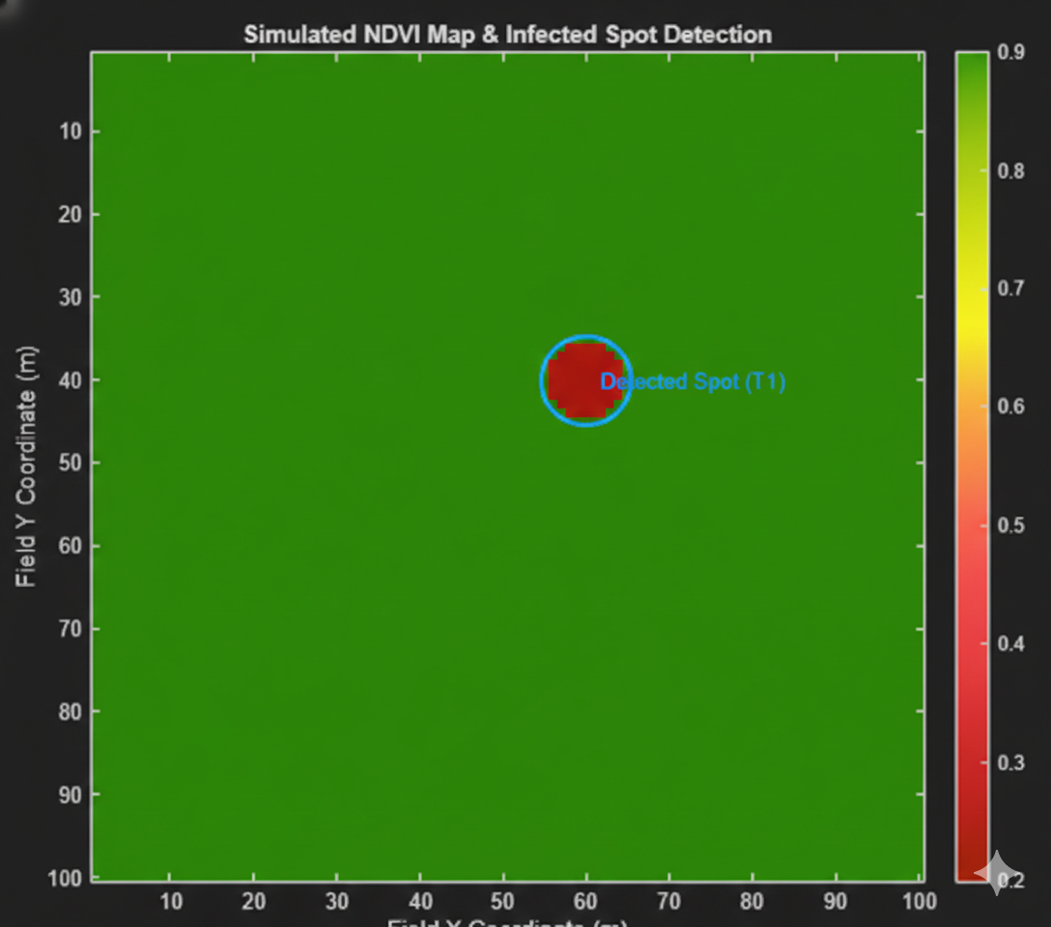
Test Result 1: Finding the Spot
We tested a farm of 100 by 100 meters.
Result: Drone 1 found the sick spot at the coordinates (60, 40). It found the problem exactly.

Slide 8
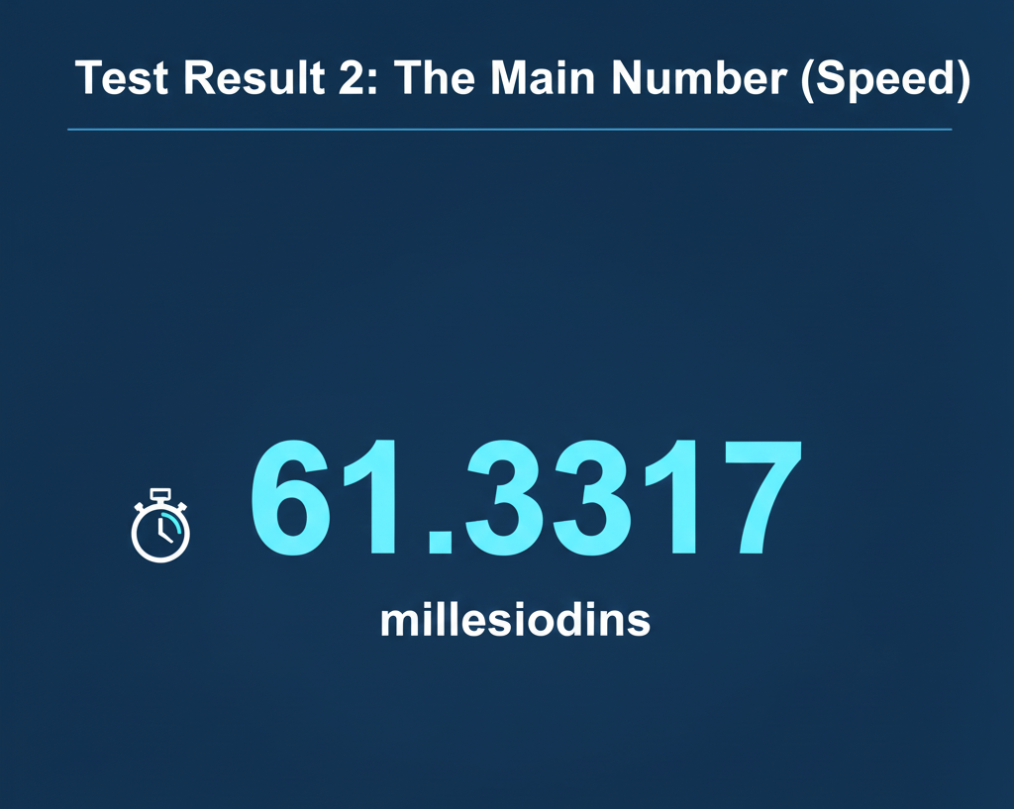
Test Result 2: The Main Number (Speed)
The most important number is the 'Talking Time' between the drones. The Number: The time was only 61.3317 milliseconds.

Slide 9
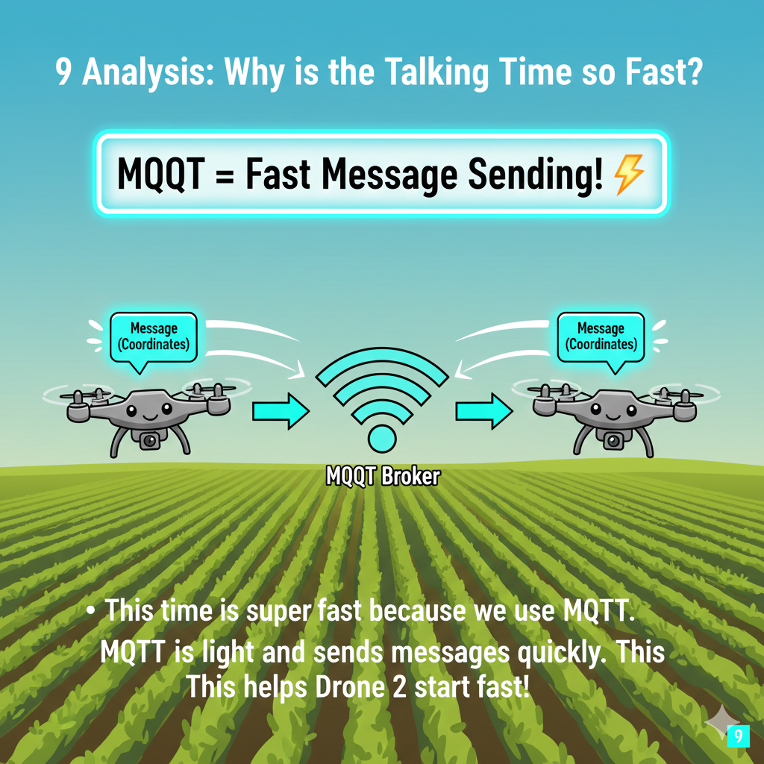
Why is the Talking Time so Fast?
We used MQTT. MQTT is made to be very light and fast. This fast time means Drone 2 starts its job very, very quickly. This helps the farm a lot.

Slide 10
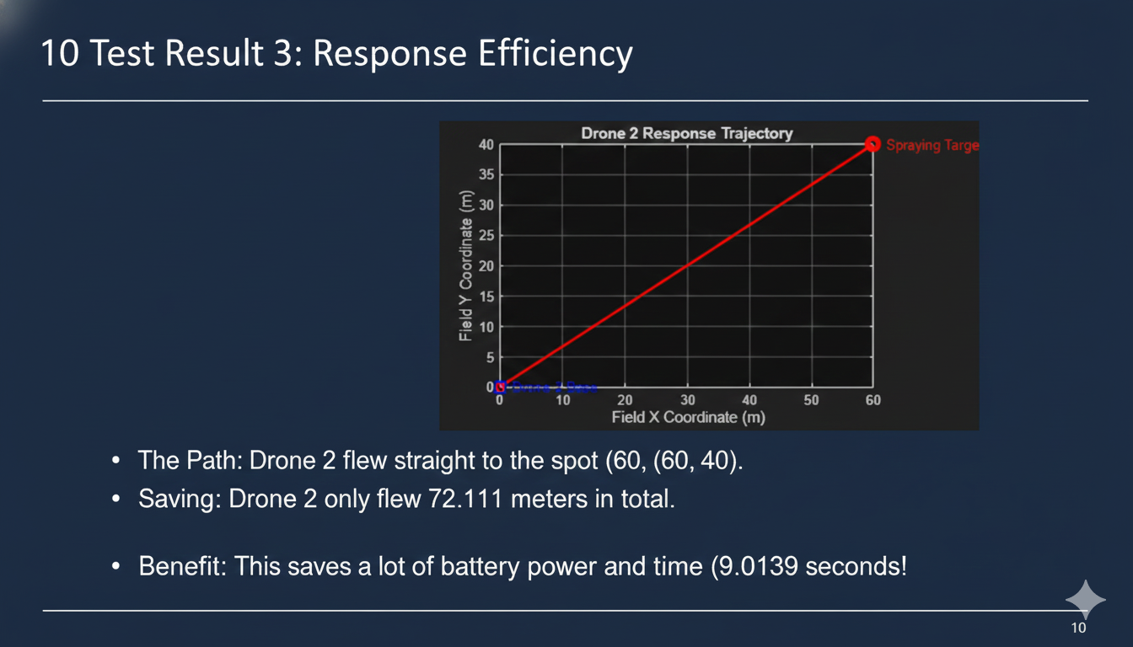
Test Result 3: Saving Power
The Path: Drone 2 flew straight to the spot (60, 40).
Saving: Drone 2 only flew 72.111 meters in total.
Benefit: This saves a lot of battery power because it does not fly the whole farm.

Slide 11
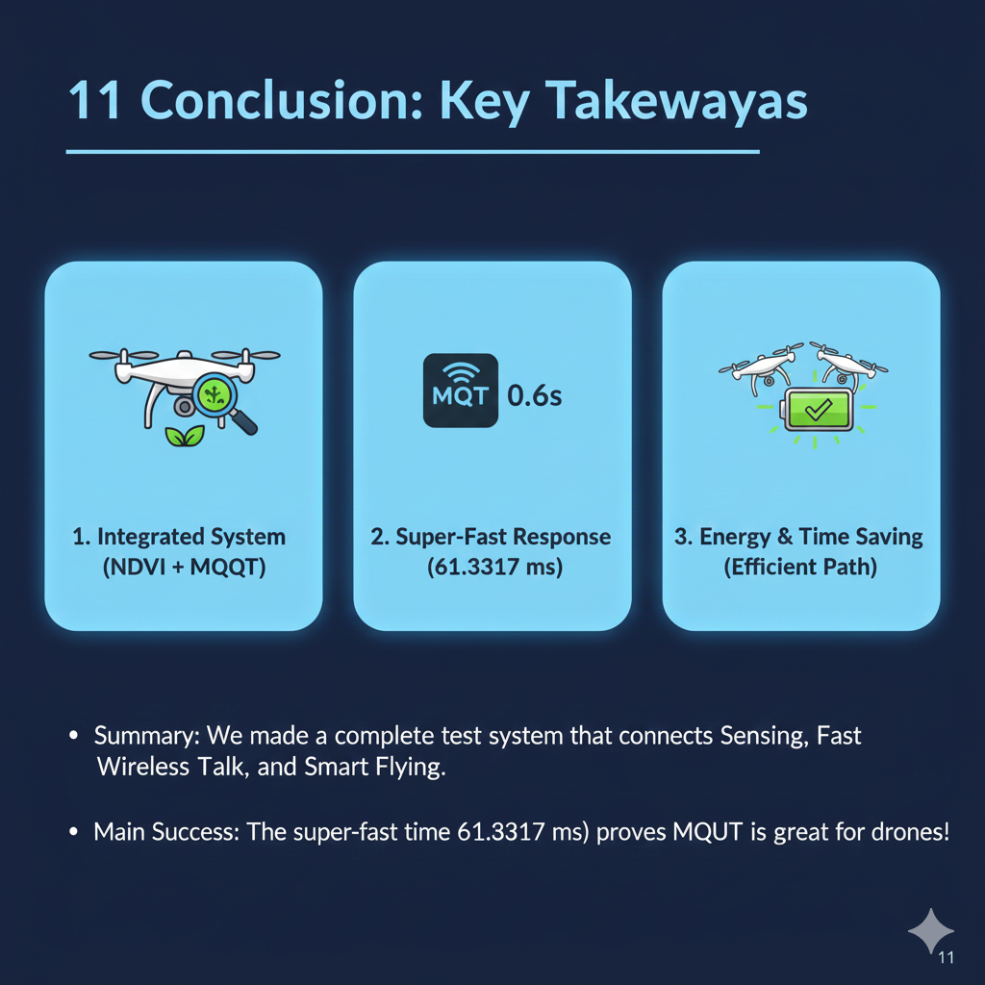
Conclusion
Summary: We made a complete test system that connects NDVI, Fast MQTT talking, and Correct Flying.
Main Success: The fast talking time of 61.3317 ms proves that this drone teamwork is a great idea.

Slide 12
ANY QUESTION ?

